Slide 1
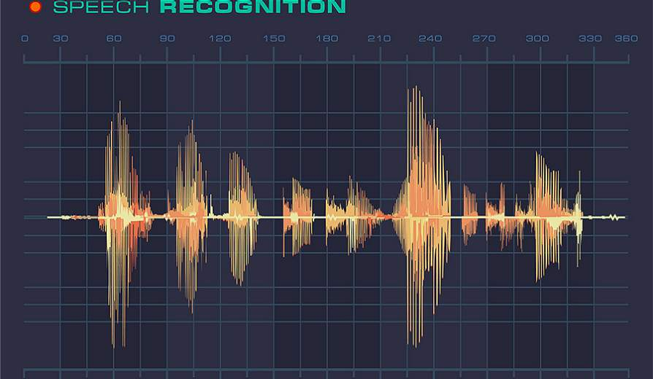

You Can Hear But You Cannot Steal
Defending against Voice Impersonation Attacks
on Smartphones
Si Chen, Kui Ren, Sixu Piao, Cong Wang, Qian Wang,
Jian Weng, Lu Su, Aziz Mohaisen
Department of Computer Science and Engineering, University at Buffalo
Department of Computer Science, West Chester University
Department of Computer Science, City University of Hong Kong
Department of Computer Science, Wuhan University
Department of Computer Science, Jinan University

Slide 2
Outline
Introduction
Problem Formulation
The Proposed Solution
Evaluation
Conclusion

Slide 3
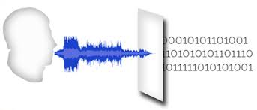
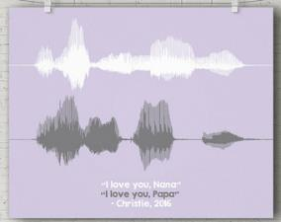
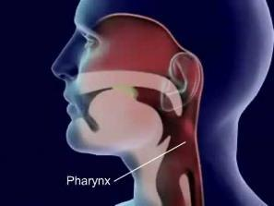
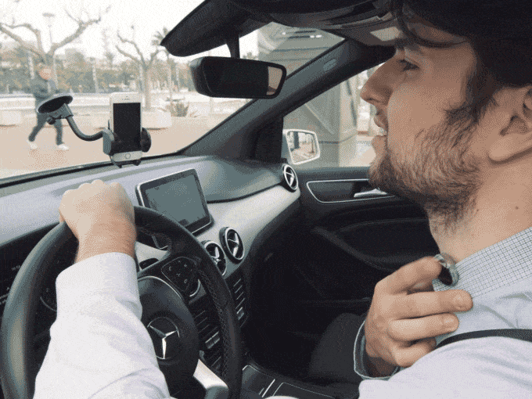
Voice Authentication
Voice, has a significant advantage over the conventional keyboard-based input methods
No memorization
Easy to Use
Low Cost
Notes:
Voice, as a convenient and efficient way of information delivery, has a significant advantage over the conventional
keyboard-based input methods, especially on small mobile devices
such as smartphones and smartwatches.
No memorization: use the special features inside the voice to authenticate (your voice is unique). The Pharynx is the main resonating chamber for the voice + physical shape of the vocal tract + motion of the mouth and pronunciations → biometrics authentication → No need to remember the password
Low cost: Use microphone to capture voice → cheap, widely adopted
Easy to Use:

Slide 4
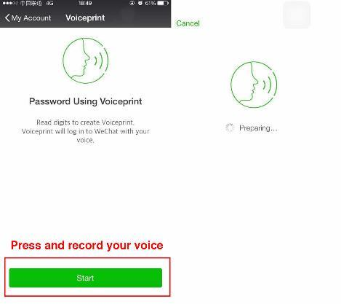




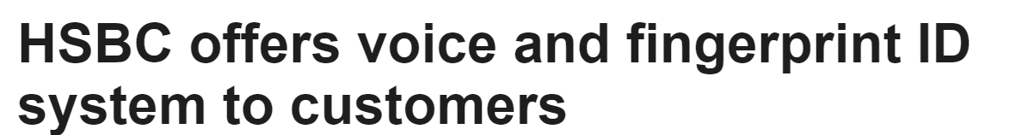



Voice Authentication on Smartphones
Voice-enable Logins
E-Commerce
Mobile Banking
Notes:
Voice-enable Logins: Google has integrated it into Android operating systems to allow users to unlock mobile devices, and Tencent has updated its WeChat mobile app to support voice logins.
SayPay Technologies provides cutting-edge biometric and voice-enabled solutions. Our solutions enable users to securely access enterprise environments, approve high-value wires and brokerage orders, sign in and make bill payments without PINs and passwords, and transaction financial functions with just the sound of their voices.
HSBC is launching voice recognition and touch security services in the UK in a big leap towards the introduction of biometric banking.

Slide 5
Outline
Introduction
Problem Formulation
The Proposed Solution
Evaluation
Conclusion

Slide 6
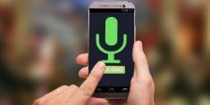
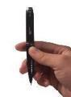
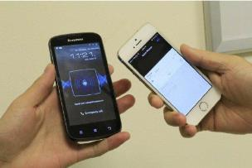
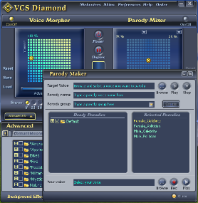

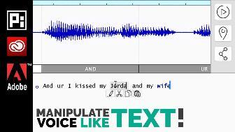
Problem Formulation
The human voice could often be exposed to the public, an attacker can:
Collect sound samples of targeted victims
Change voice biometrics by using different methods
Launch voice impersonation attacks to spoof those voice-based applications
Voice Replay Attack
Voice Morphing Attack
Voice Synthesize Attack
Notes:
Voice Morphing Attack. In this type of attack, the attacker is able to imitate the target’s voice by applying voice morphing (conversion) techniques.
Voice Synthesize (Example: Adobe VOCO)
Attack: This type of attacker is able to synthesize target voice by using the state-of-the-art speech synthesizers techniques.
We assume the attacker is ableto use text-to-speech (TTS) technique to generate the natural-sounding synthetic speech of the targeted user from any inputtexts.
The attacker tries to spoof the speaker verification system by directly broadcasting the synthetic voice using a loudspeaker.

Slide 7

Problem Formulation
Adversary Model
Voice impersonation attacks
Machine-based Voice Impersonation Attack
Voice Replay Attack
Voice Morphing Attack
Voice Synthesize Attack
Human-based Voice Impersonation Attack
Human Mimicking

Slide 8
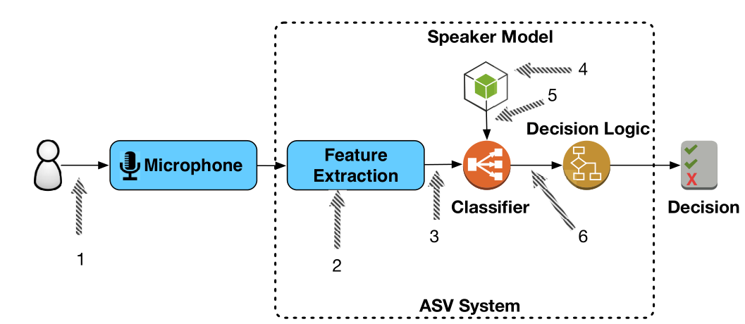
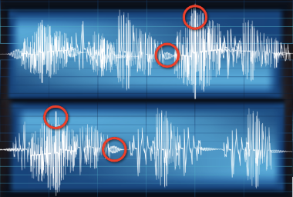
Existing Solutions: Automatic speaker verification (ASV) system
A generic automatic speaker verification (ASV) system with seven possible attack points
ASV system:
Effective in detecting human voice imitation (human mimicking)
Ineffective in detecting machine-based voice impersonation attacks
Notes:
Hence, more robust designs resilient to both human-based and machine-based voice impersonation attacks are in great demand yet to be fully explored.
The traditional methods of defending against the voice impersonation attacks require an automatic speaker verification (ASV) system, which employs unique spectral and prosodic features of a user’s voice for user authentication.
However, current ASV systems are far from perfect. While they are effective in detecting human-based voice impersonation attacks (human voice imitation) they are widely known for their inability to detect voice replay attacks.

Slide 9
Problem Formulation
Can we build software-based defense system tailored for mobile platforms against voice impersonation attacks?
… and meet these design goals
High accuracy
Easy to integrate with off-the-shelf mobile phones
Low latency
Low computational cost

Slide 10
Problem Formulation
Can we build software-based defense system tailored for mobile platforms against voice impersonation attacks?
… and meet these design goals
High accuracy
Easy to integrate with off-the-shelf mobile phones
Low latency

Slide 11
Outline
Introduction
Problem Formulation
Proposed Solution
Evaluation
Conclusion

Slide 12
Proposed Solution
Voice Replay Attack
Voice Morphing Attack
Voice Synthesize Attack
Notes:
our key insight is to detect the magnetic field produced by the conventional loudspeakers. By using the magnetometer (compass) in modern smartphones, we can distinguish between a human speaker and a computer loudspeaker, since the human vocal tract would not produce any magnetic field.

Slide 13
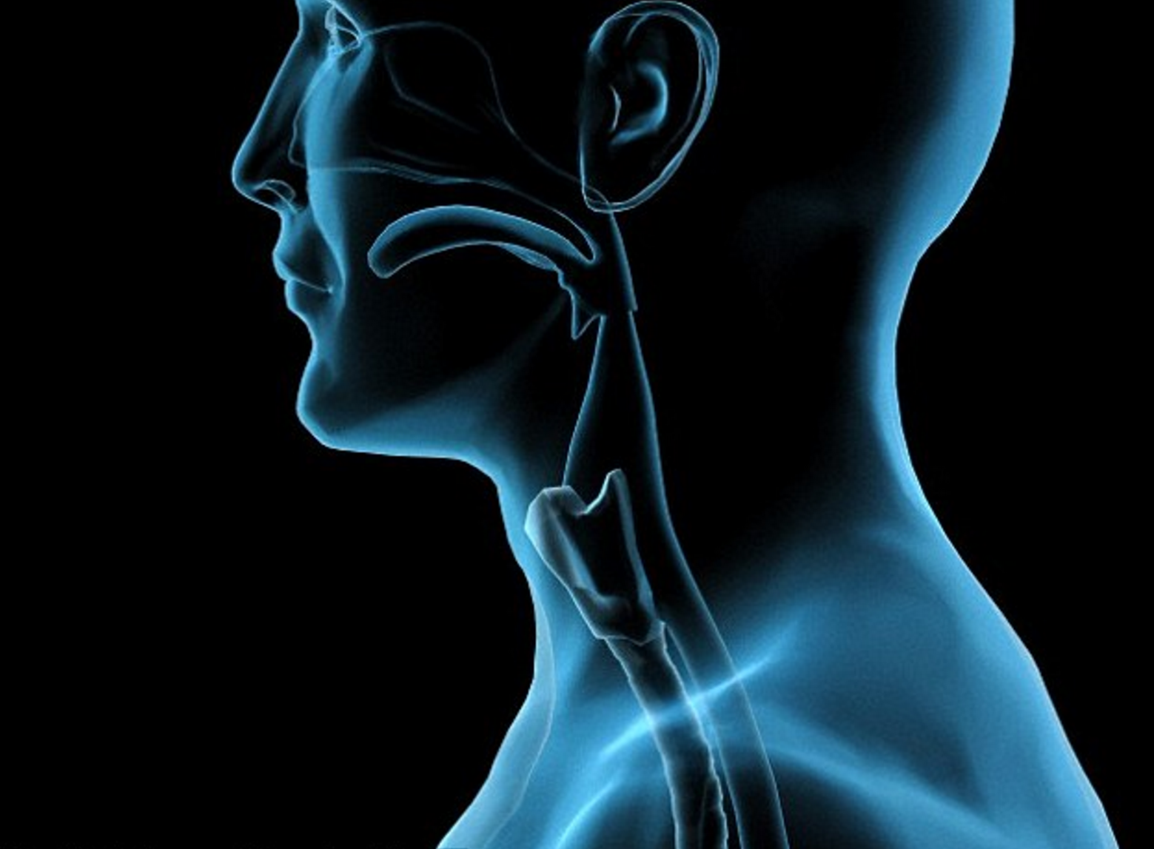
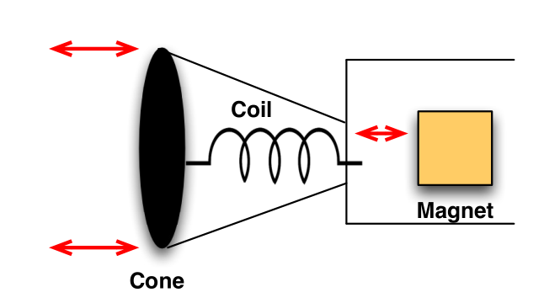
Proposed Solution
The human vocal tract
The architecture of conventional loudspeaker
Key insight:
The human vocal tract → No magnetic field
The conventional loudspeakers → Has magnetic field
Use the magnetometer (compass) in smartphone to detect!
Notes:
our key insight is to detect the magnetic field produced by the conventional loudspeakers. By using the magnetometer (compass) in modern smartphones, we can distinguish between a human speaker and a computer loudspeaker, since the human vocal tract would not produce any magnetic field.

Slide 14
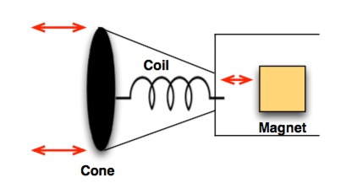
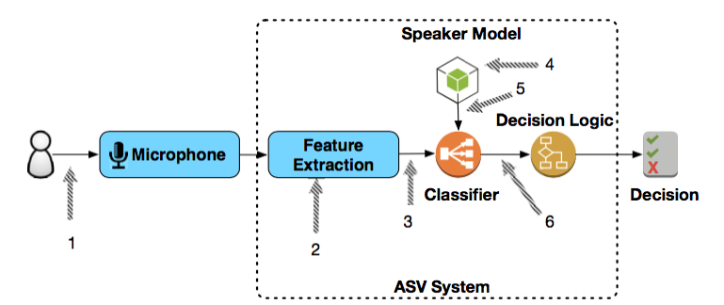
Proposed Solution
Machine-based Voice Impersonation Attack
magnetometer (compass) equipped on modern smartphones
Human-based Voice Impersonation Attack
Spear speaker verification system

Slide 15
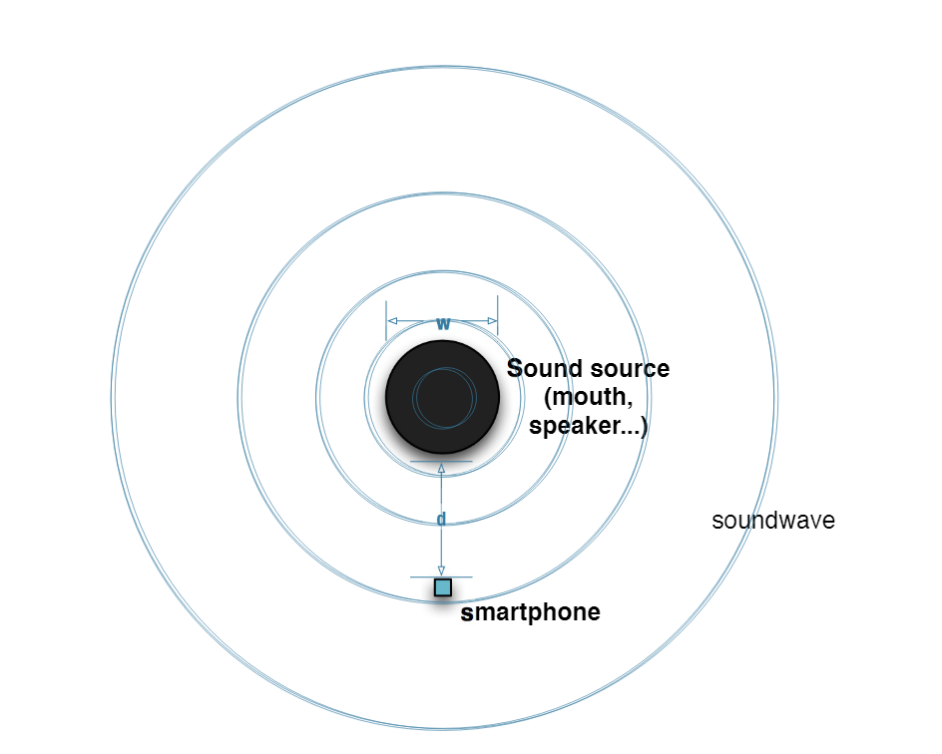
Proposed Solution
To successfully leverage our key insight, we require users to place the smartphone as close as possible to the sound source.
Notes:
This is because the magnetic field produced by the loudspeaker can only be detected within a short range.
However, the distance between the smartphone and the sound source is hard to measure.
Therefore, we design non-intrusive use cases to confine the moving pattern of the smartphone and assist in measuring the distance.
As shown in this Figure, our scheme requires the user first to open our mobile application and hold the smartphone near his head vertically or horizontally (a similar interaction model has been adopted by [11]);
The user starts speaking the voice command while moving the smartphone towards his or her mouth at the same time.
Finally, the user waits for our application to verify his identity. During this process, our application first collects the acoustic data and the reading of the inertial sensors, and then feeds them into the verification pipeline.

Slide 16
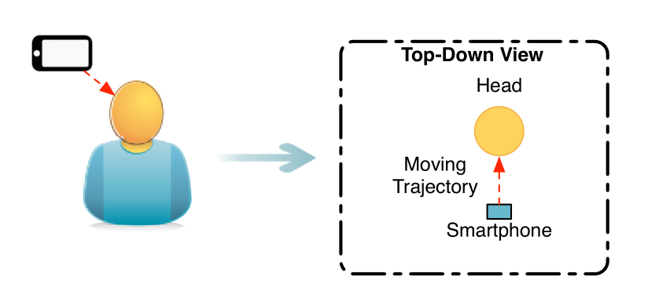
Proposed Solution
Move towards the mouth
Notes:
This is because the magnetic field produced by the loudspeaker can only be detected within a short range.
However, the distance between the smartphone and the sound source is hard to measure.
Therefore, we design non-intrusive use cases to confine the moving pattern of the smartphone and assist in measuring the distance.
As shown in this Figure, our scheme requires the user first to open our mobile application and hold the smartphone near his head vertically or horizontally (a similar interaction model has been adopted by [11]);
The user starts speaking the voice command while moving the smartphone towards his or her mouth at the same time.
Finally, the user waits for our application to verify his identity. During this process, our application first collects the acoustic data and the reading of the inertial sensors, and then feeds them into the verification pipeline.

Slide 17
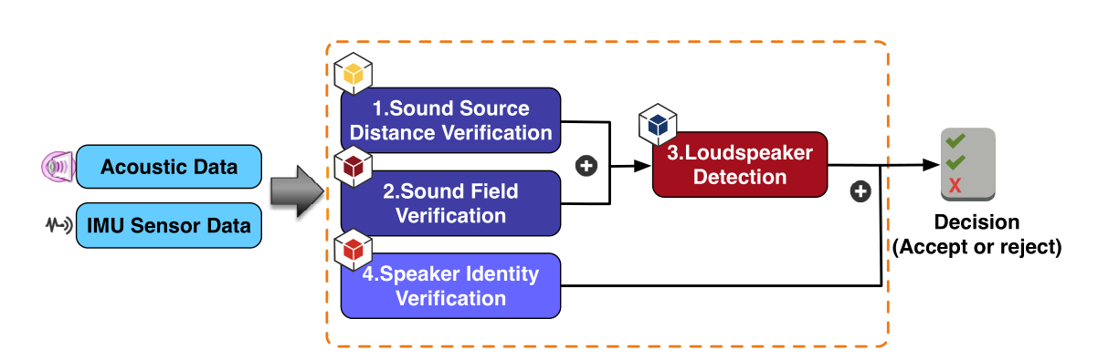
Proposed Solution
The architecture of our defense system
Sound Source Distance Verification
Reconstruct the moving trajectory of the smartphone
Calculate the distance between sound source and smartphone
Sound Field Verification
Justify whether the received sound is broadcast from a human mouth
Loudspeaker Detection
Detect the magnetic field emitted from the loudspeaker.
Speaker Identity Verification
Defend against human-based voice impersonation attacks
Notes:
This is because the magnetic field produced by the loudspeaker
can only be detected within a short range. However, the
distance between the smartphone and the sound source is
hard to measure. Therefore, we design non-intrusive use cases
to confine the moving pattern of the smartphone and assist
in measuring the distance. As shown in Fig. 3, our scheme
requires the user first to open our mobile application and
hold the smartphone near his head vertically or horizontally
(a similar interaction model has been adopted by [11]); the
user starts speaking the voice command while moving the
smartphone towards his or her mouth at the same time. Finally,
the user waits for our application to verify his identity. During
this process, our application first collects the acoustic data and
the reading of the inertial sensors, and then feeds them into
the verification pipeline.

Slide 18
Proposed Solution
The architecture of our defense system
Our defense system consists of four verification components for defending against voice impersonation attacks:
Component 1, 2, 3: Detect Machine-based voice impersonation attacks
Component 4: Detect human-based voice impersonation attacks

Slide 19
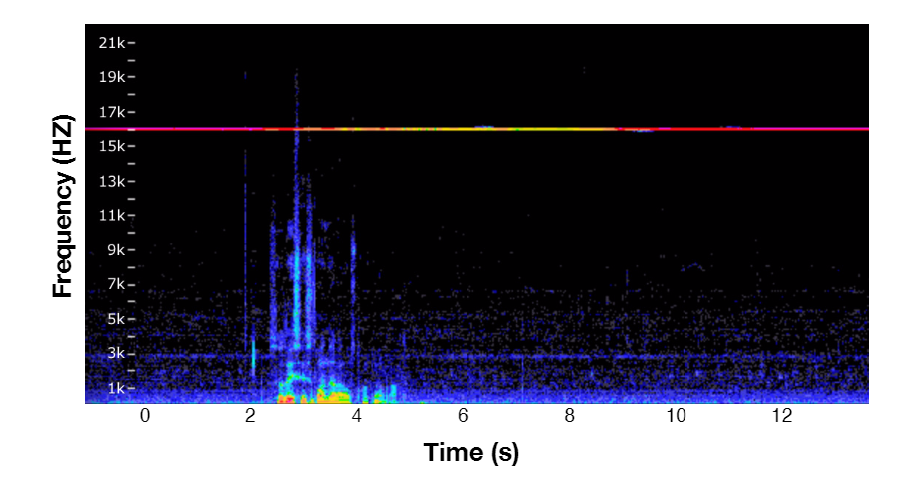
The Proposed Solution
Sound Source Distance Verification
Reconstruct the moving trajectory of the smartphone
Calculate the distance between sound source and smartphone
Motion Trajectory Reconstruction
Acoustic sound
IMU Sensor

Slide 20
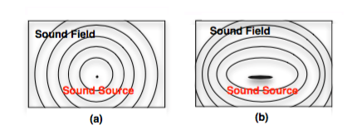
The Proposed Solution
Sound Field Verification
Justify whether the received sound is broadcast from a human mouth
The sound field created by
(a) a point sound source and (b) created by a strip-type sound source.

Slide 21
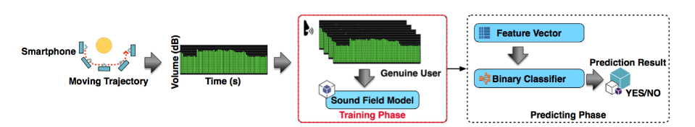
The Proposed Solution
Sound Field Verification
The sound source validation process, containing two phases:
i) training phase and ii) predicting phase.

Slide 22
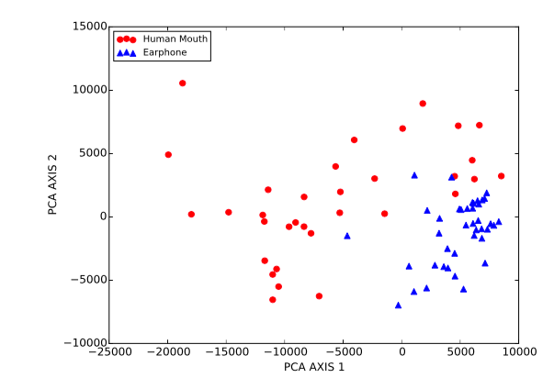
The Proposed Solution
Sound Field Verification
The feature point of the human mouth sound field (red circle)
and the earphone sound field (blue triangle) after principal component analysis (PCA)

Slide 23
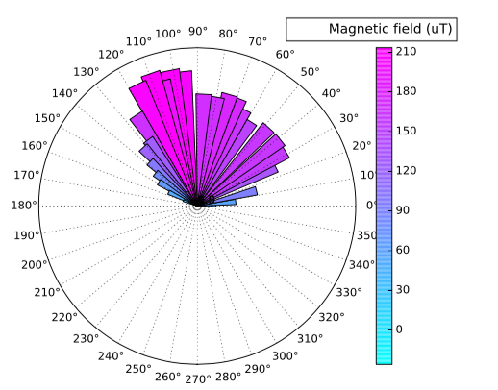
The Proposed Solution
Loudspeaker Detection
Detect the magnetic field emitted from the loudspeaker.
Polar graph of the magnetic field reading for a conventional loudspeaker.

Slide 24
Outline
Introduction
Problem Formulation
The Proposed Solution
Evaluation
Conclusion

Slide 25
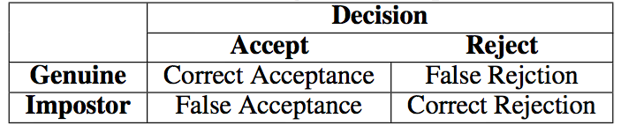
Evaluation
Methodology
We design and build a small testbed environment
a real loudspeaker
a smartphone hardware.
Our evaluation focuses on the machine-based voice impersonation anti-spoofing sub-system
We choose the standard automatic speaker verification metrics
False Acceptance Rate (FAR)
False Rejection Rate (FRR)
Equal Error Rate (EER)
the rate at which the acceptance and rejection errors are identical
Performance Metrics

Slide 26
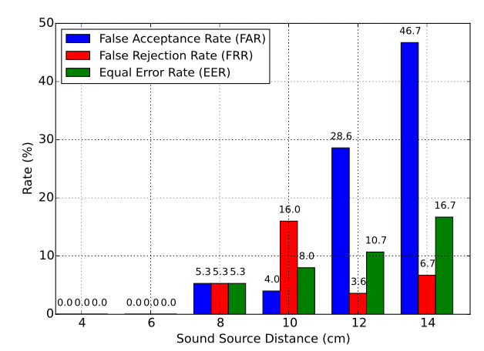
Evaluation
Impact of sound source distance of our defense scheme.
The FAR, FRR and EER values of our system are all equal to zero when the distance is less than or equal to 6 cm.

Slide 27
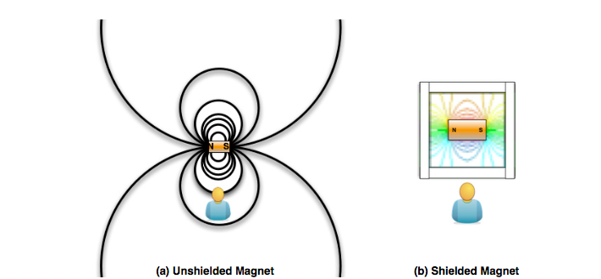
Evaluation
The magnetic field distribution of: (a) unshielded magnet and (b) shielded magnet.
Mu-metal
Mu-metal is a nickel-iron alloy
Perfect to shield the magnetic field.

Slide 28
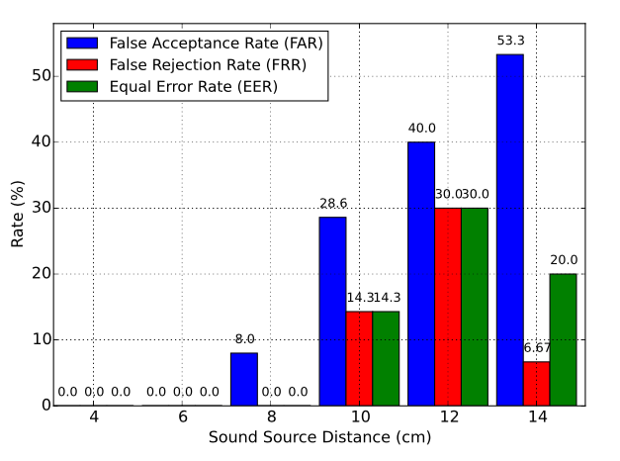
Evaluation
Impact of sound source distance for Magnetic field shielding of our defense scheme.

Slide 29
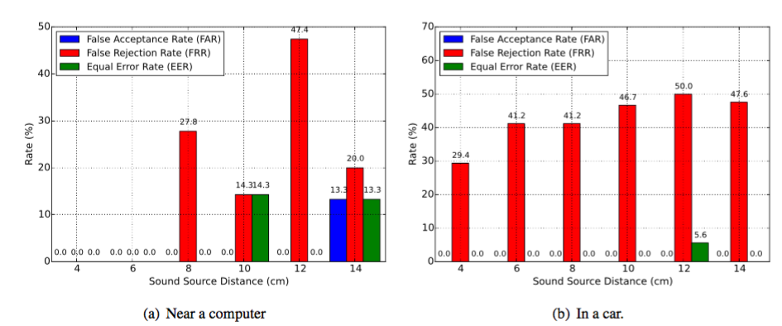
Evaluation
The FAR, FRR and EER values of our system with environmental magnetic interference: (a) Near a computer (iMac 27’ Late 2009) and (b) In a car’s front seat (Hyundai Sonata 2012).

Slide 30
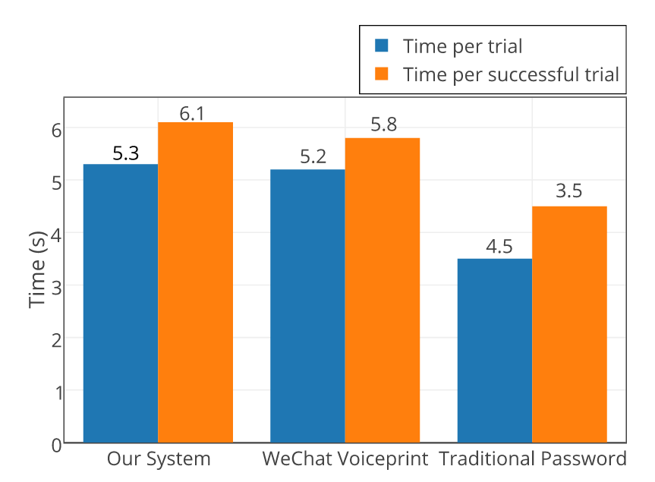
Evaluation
Authentication time comparison

Slide 31
Outline
Introduction
Problem Formulation
The Proposed Solution
Evaluation
Conclusion

Slide 32
Conclusion
Software-based solution tailored for mobile platform for defending against voice impersonation attacks
Defeat the vast majority of voice impersonation attacks and significantly raise the level of security for existing voice-based mobile applications
Our system achieves design goals
High accuracy (~100% accuracy when <= 6 cm)
Easy to integrate with off-the-shelf mobile phones (software-based approach)
Low latency (~ 6.1s for authentication)

Slide 33

Q & A

